Slide 1
Geomapping Crashes in Washington DC GW Data Analytics Bootcamp Project 1
Amanda Walker
Jennifer P.
Kaori Niina
Maggie Leeker

Slide 2

Research Questions:
Have accidents in DC increased or decreased over the last 10 years?
When do most accidents occur? At what time of day? Month? Season?
Where do most accidents in DC occur?
What accident types are most recurring?
What intersections are most dangerous for bikers? Pedestrians? Drivers?

Slide 3
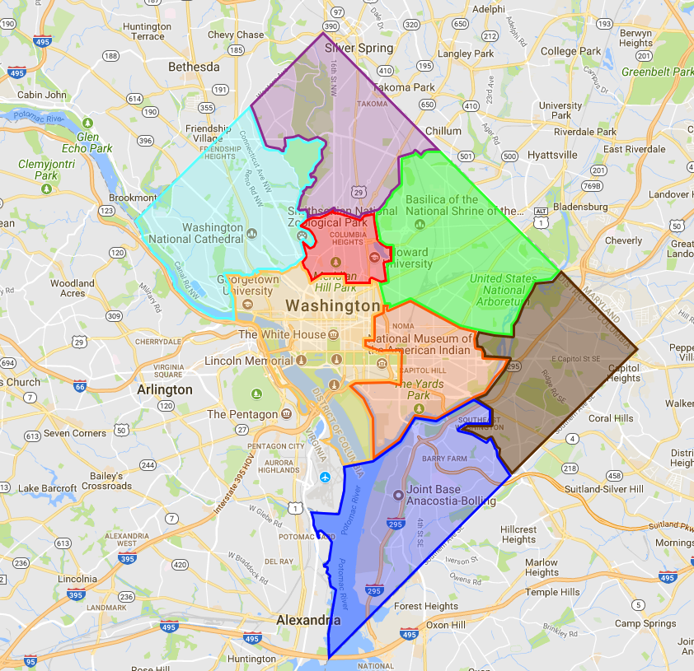
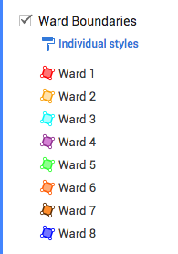
DC Wards Map

Slide 4
Research Questions:
Have accidents in DC increased over the last 10 years?
When do most accidents occur? At what time of day? Month? Season?
Where do most accidents in DC occur?
What accident types are most recurring?
What intersections are most dangerous for bikers? Pedestrians? Drivers?

Slide 5
Have accidents increased over the last 10 years?

Slide 6
Have accidents increased over the last 10 years?

Slide 7
Research Questions:
Have accidents in DC increased or decreased over the last 10 years?
Where do most accidents in DC occur?
When do most accidents occur? At what time of day? Month? Season?
What accident types are most recurring?
What intersections are most dangerous for bikers? Pedestrians? Drivers?

Slide 8
DC City Center: Most Accidented Neighborhood
TO BE UPDATED

Slide 9
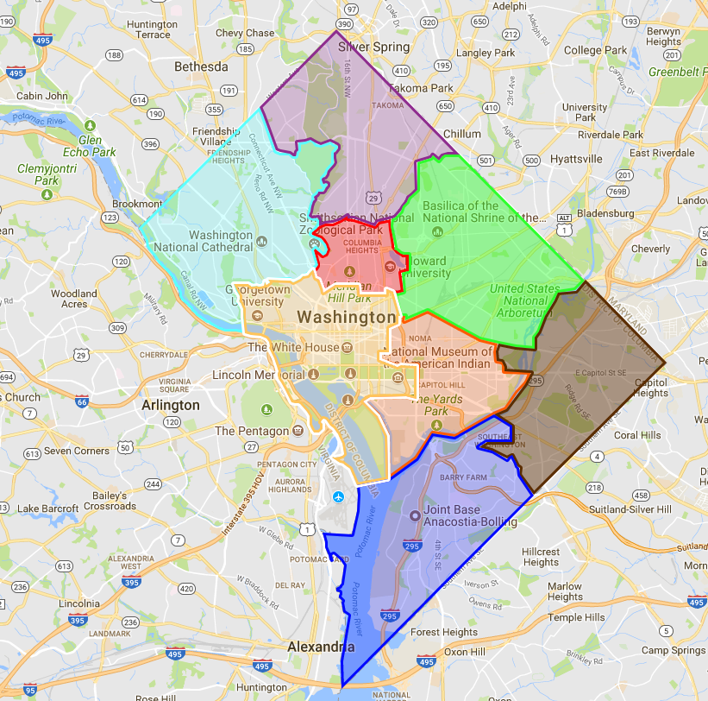
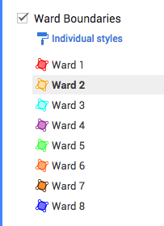
Ward 2: Let’s Deep Dive

Slide 10
Research Questions:
Have accidents in DC increased or decreased over the last 10 years?
Where do most accidents in DC occur?
When do most accidents occur? At what time of day? Month? Season?
What accident types are most recurring?
What intersections are most dangerous for bikers? Pedestrians? Drivers?

Slide 11
Time of Crashes in DC

Slide 12
Research Questions:
Have accidents in DC increased or decreased over the last 10 years?
Where do most accidents in DC occur?
When do most accidents occur? At what time of day? Month? Season?
What accident types are most recurring?
What intersections are most dangerous for bikers? Pedestrians? Drivers?

Slide 13
Research Questions:
Have accidents in DC increased or decreased over the last 10 years?
Where do most accidents in DC occur?
When do most accidents occur? At what time of day? Month? Season?
What accident types are most recurring?
What intersections are most dangerous for bikers? Pedestrians? Drivers?

